Slide 1


AirBnb Analysis
Akshay R. Salve
iNeuron

Slide 2
Objective :-
To get the insights of revenue and reviews of the bookings in the various neighbourhoods in the Amsterdam. Insights includes average ratings by room types , average price bye room type, average price in each neighbourhood , etc.
To get insights about top neighbourhoods according to reviews and average price for each room type. These insights will help the stakeholders to expanding their network , increase the possibilities of travelling and improve the services where lacking, etc.

Slide 3
Data Sharing Agreement :-
Sample file name (ex :- Airbnb_prices.csv )
Length of Data stamp( 8 Digits )
Length of Time stamp ( 6 Digits )
Number of Columns
Column Name
Column Data type

Slide 4
Architecture :-

Slide 5
Data Overview :-
The data includes single csv file with all examples , ordered by date ( 22 July 2017 to 23 July 2017.
The Number of Instances – 18724 for Airbnb_price.csv
Number of Attributes – 19 Attributes

Slide 6
Key Performance Indicators :-
Key indicators displaying a summary of bookings , pricing and reviews information based on various parameters :-
Room_ID – Showing distinct Id of room
Survey_ID – Showing Survey Number
Host_Id – Showing Distinct Id of hosts
Room Type – Showing Type of Rooms available
Country
City
Neighbourhood – Names of Neighbourhoods providing booking facilities.
Reviews – Number of Reviews

Slide 7
Key Performance Indicators :-
Overall Satisfaction – Ratings Given by Accomaodates
Accommodate – Number of accommodates
Bedrooms – Showing number of bedrooms in room
Bathrooms - Showing number of Bathrooms in room
Price – Price of room
Minstay
Name
Last_modified – Dates
Latitude – Showing the north-south coordinate of room location
Longitude – Showing the east – west coordinate of room location
Location – Showing the location of rooms

Slide 8
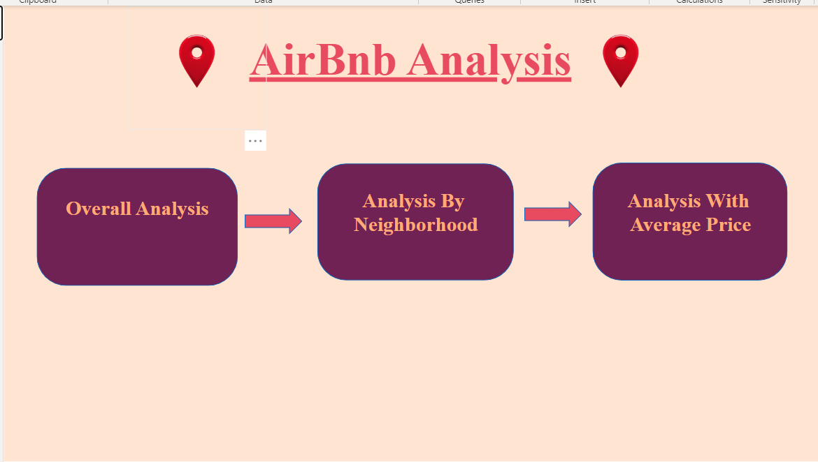
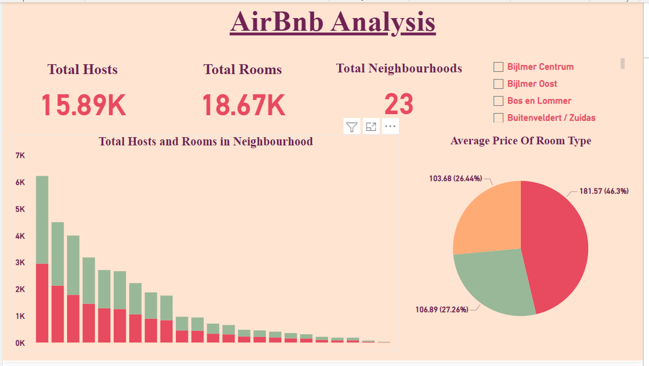
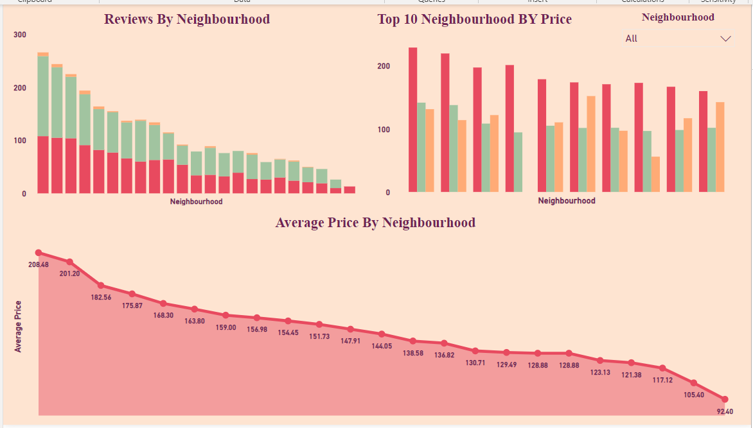
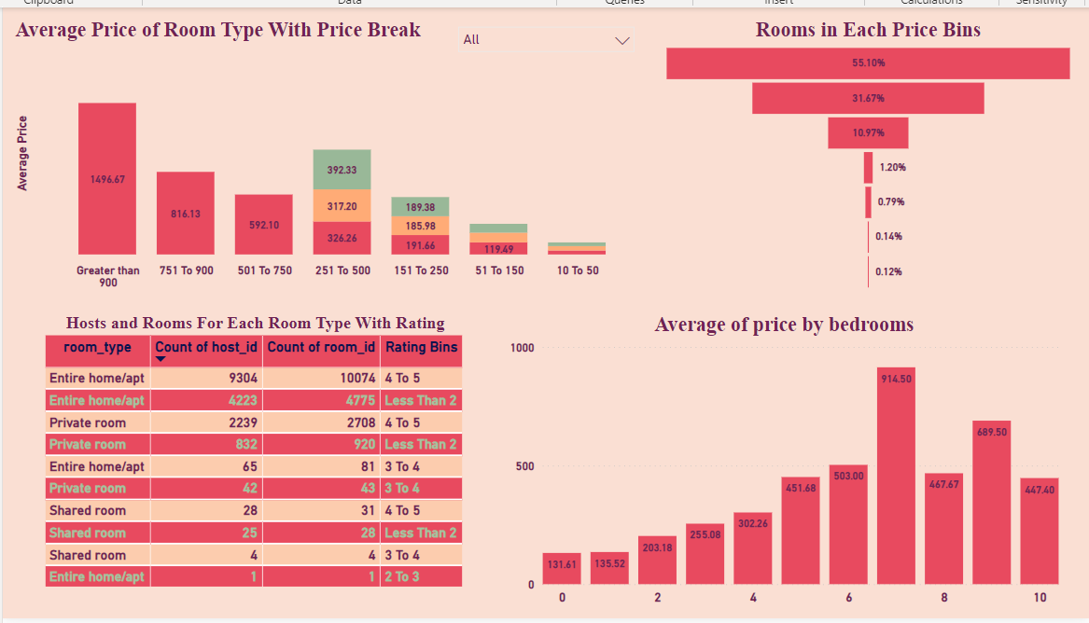
Dashboard:-

Slide 9
Insights Summary :-
There are Total 15.89K hosts are providing the services.
There are Total 18.67K rooms are available.
Total of 23 neighbourhoods in the Amsterdam have Airbnb services.
De Baarsjes / Oud West has highest number of hosts and rooms available in service.
Whereas De Pijp / Rivierenbuurt has the second highest number hosts and rooms available in service.
The average price for different types of rooms are -
- Private Room – $ 106.89
- Shared Room - $ 103.68
- Entire Home / Appt - $ 181.57

Slide 10
Insights Summary :-
There are 46.3% rooms are in the category of Entire Home / Appt which is almost close to half of the rooms.
Whereas Private rooms are 27.26% and Shared rooms are 26.44% from the total rooms.
Centrum west , De Baarsjes / Oud West and Centrum Oost are the top three neighbourhoods which have received the maximum number of reviews as 266 , 244 and 212 resp.
The Top 3 Expensive Neighbourhoods by average prices are –
- Centrum West :- $ 208.48
- Centrum Oost :- $ 201.20
- Noord West / Noord maiden :- $ 182.56

Slide 11
Insights Summary :-
Top 3 cheapest Neighbourhoods by average price are –
- Osdorp - $ 117.12
- Bijlmer Oost - $ 105.40
- Bijlmer Centrum - $ 92.40
The prices of rooms vary with the bedroom sizes. The rooms with 7 bedrooms have highest average price of $914.50 which is also more than rooms having bedrooms more than 7.
55.10% rooms are in the price bracket of $51 to $150 which is more than half of the rooms. Which is followed by price bracket of $151 to $250 price bracket which has 31.67% of total rooms.

Slide 12
Insights Summary :-
The average room prices of each price brackets are –
$10 to $50 -
Entire home / Appt – $39.62
Private Room – $47.22
Shared Room - $ 36.64
$51 to $150 –
Entire home / Appt – $119.49
Private Room – $99.65
Shared Room - $87.55

Slide 13
Insights Summary :-
$151 to $250 -
Entire home / Appt – $191.66
Private Room – $185.98
Shared Room - $189.38
$251 to $500 –
Entire home / Appt – $326.26
Private Room – $317.20
Shared Room - $392.33

Slide 14
Insights Summary :-
$501 to $750 -
Entire home / Appt – $592.10
$751 to $900 –
Entire home / Appt – $816.13
Greater Than 900 –
Entire home / Appt – $1496.67

Slide 15
Insights Summary :-
Q.1) What’s the source of the dataset ?
ANS – This dataset is provide by the client.
Q.2) What was the type of Dataset ?
ANS – The Data is available in csv format.
Q.3) What’s the complete flow you followed in this project ?
ANS – Refer all slides in sequence for better understanding.
Q.4) What steps I should follow to get insights from the data?
ANS – Step.1 Download the data and store it in a location in your pc.
Step.2 . Open Airbnb_Analysis_Report.pbix in your pc and then you can see all the insights.

